Slide 1
MIAMAT Morbidity Impacts of Active Mobility Appraisal Tool
User Testing (Round 1)

Slide 2
Goals for Today
Starting point:
Novel tool to estimate morbidity impacts of active travel schemes
First time presentation to “potential users”
Tool is 95% functional (but some bugs to be expected. Performance is slow)
1. Priority:
Test tool navigation and interpretation of results
Gain inputs/feedback on key “final stretch” improvements (of “v1”)
2. Priority
Gain additional inputs/feedback on any aspect related to tool and methodology (possibly of relevance beyond project scope)

Slide 3

The health model and its emulator
The aim was to bring morbidity into appraisal, not just mortality.
Appraisal has counted deaths prevented and years of life gained; ill health while alive was not valued.
A multi-state model tracks disease as well as survival, so it can report morbidity as well as mortality.
Running that model in full for every appraisal would be slow and demanding.
So we use an emulator: benefit per additional mMET-hour per week (e.g. about 15 min walk)
It is far quicker and easier to run, which makes appraisal in this app practical.
Outputs are prevented deaths and disease cases, life-years and HALYs.

Slide 4

Health-adjusted life years (HALYs)
HALYs combine length and quality of life in a single measure.
One HALY is one year of life lived in full health.
Years lived with disease count for less, weighted by severity.
A scheme gains HALYs both by postponing death and by preventing illness.
Weights are comorbidity-adjusted, with a residual adjustment for conditions not modelled.
We propose HALYs as the primary input for monetisation of health benefits.
Prevented deaths, disease cases and life-years are still reported alongside.

Slide 5
What this adds to appraisal
Beyond a population-average, mortality-only calculation.
Effects are estimated for individuals with their own age, sex, deprivation and starting activity, then summed, rather than for an average person scaled up.
Morbidity is included: sixteen diseases, prevalence over time, and HALYs alongside deaths and life years.
The time profile of benefit is modelled explicitly over 40 years rather than assumed.
Who changes matters: the same number of new trips gives different health returns depending on who makes them, and the tool shows that.
Every assumption used to complete an appraisal is recorded with its source, so a result can be audited.

Slide 6
From activity change to health impacts
Benefits are stored per unit of activity, then scaled to the scheme.
Impacts are expressed per additional marginal MET-hour per week (mMET-h).
Estimates are held by sex, mortality decile (based on deprivation), single year of age and activity group.
Non-linear dose-response means the same increment benefits the least active most.
Benefits flatten above about 20 mMET-h per week; this will change for diabetes in the next model run.
Each cell averages 1,000 Monte Carlo runs over 40 years.
Results are held for every year of the appraisal period, so we can report a single year or the total.
A person's benefit is their stored estimate times their extra activity: Do Something minus Do Minimum, our counterfactual and reference cases.
Person in synthetic population
Extra activity, DS minus DM (mMET-h)
Look up matching estimate
Impacts by year, and total

Slide 7


Scope and assumptions
What the model covers, and what to bear in mind.
Pathway: physical activity from travel, against background non-travel activity modelled in the synthetic population.
Walking, cycling, e-bike and walking to public transport are considered together, including mode shift between them.
Benefits accumulate over an appraisal period of up to 40 years; shorter periods can be reported.
Air pollution and road injuries are appraised separately in AMAT, not here.
Risks come from our dose-response meta-analysis of cardiovascular disease, cancer and mortality (Garcia et al., BJSM 2023), plus our other reviews on diabetes and depression.

Slide 8
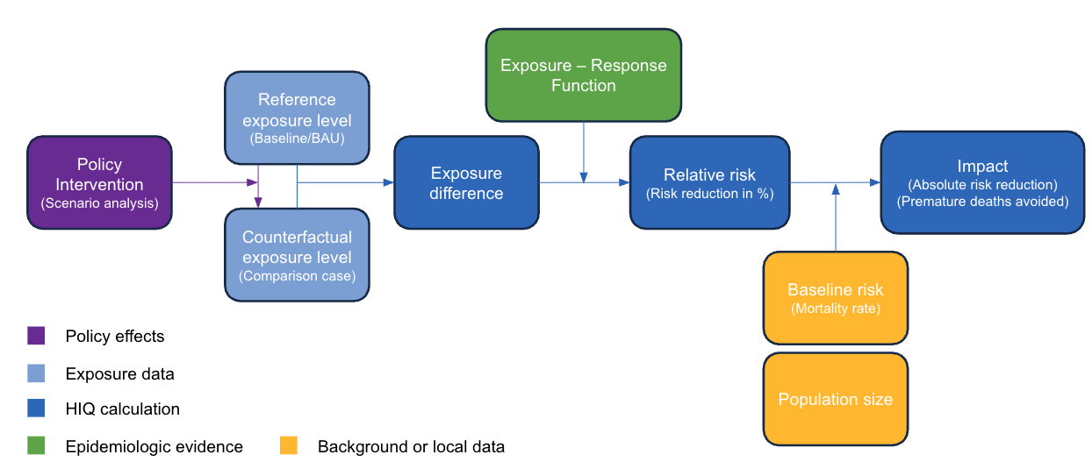
Basic Tool Concept
Combine a complex health simulation with a simple appraisal interface
Extensive Population Data (Synthetic Population)
Simple Appraisal Tool (comparative risk assessment): Reference vs. Counterfactual (without vs. with)
How to insert details without overloading?
Complex Health Model/Data (MSLT Simulation)

Slide 9
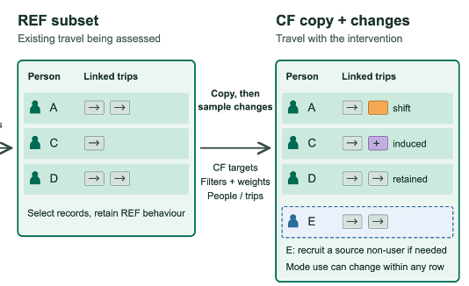
Tool Layout (Workflow)
Main user input: Active travel volume Users – Trips – Dist/dur. – Mode shares Reference and Counterfactual
Tool estimates number of individuals and trips based on user inputs and assumptions
Advanced users: Refine scope and characteristics of assessed individuals and trips
Tool samples individuals and trips from source data, switches trips to active travel, recalculates physical activity, rejoins health outcomes
Health impact = CF - REF

Slide 10
Tool layout: Tabs 1 and 2
Tab1: Define scope of appraisal (not shown on the left)
Basic or advanced
Geographic source population/data (LAD)
Active modes assessed
Tab2: Provide “active travel volume” – 4 input unit options
Basic workflow:
Optionally specify population size (number of mode users)
Optionally review assumptions (parameter values)
Advanced workflow:
Refine population and trips data scope and distributions (Tab3 and Tab4)

Slide 11
Tool layout: Tabs 3 to 5
Tab3: Refine “who is changing their travel behaviour”
Optionally edit the size of the REF and CF population by mode, manually or with sliders.
Optionally edit their characteristics: age, gender and physical activity.
Tab4: Refine “which trips are switching mode”
Optionally edit the size of the REF and CF trips, in total and by mode.
Optionally edit their characteristics: distance distribution and mode diversion rates.
Sliders offer percentage reduction, trip distance and mode shift.
Tab5: Results
Basic: main results and export options.
Advanced: basic plus interactive plots for results exploration.

Slide 12
Overview of data (Individuals + Trips)
Real Population (Entire LAD pop) Leeds: 800k
Synthetic pop. (Source data) (1:20, (1:120))
Reference Data (Entire or sub pop)
Counterfactual Data (+- REF)

Slide 13
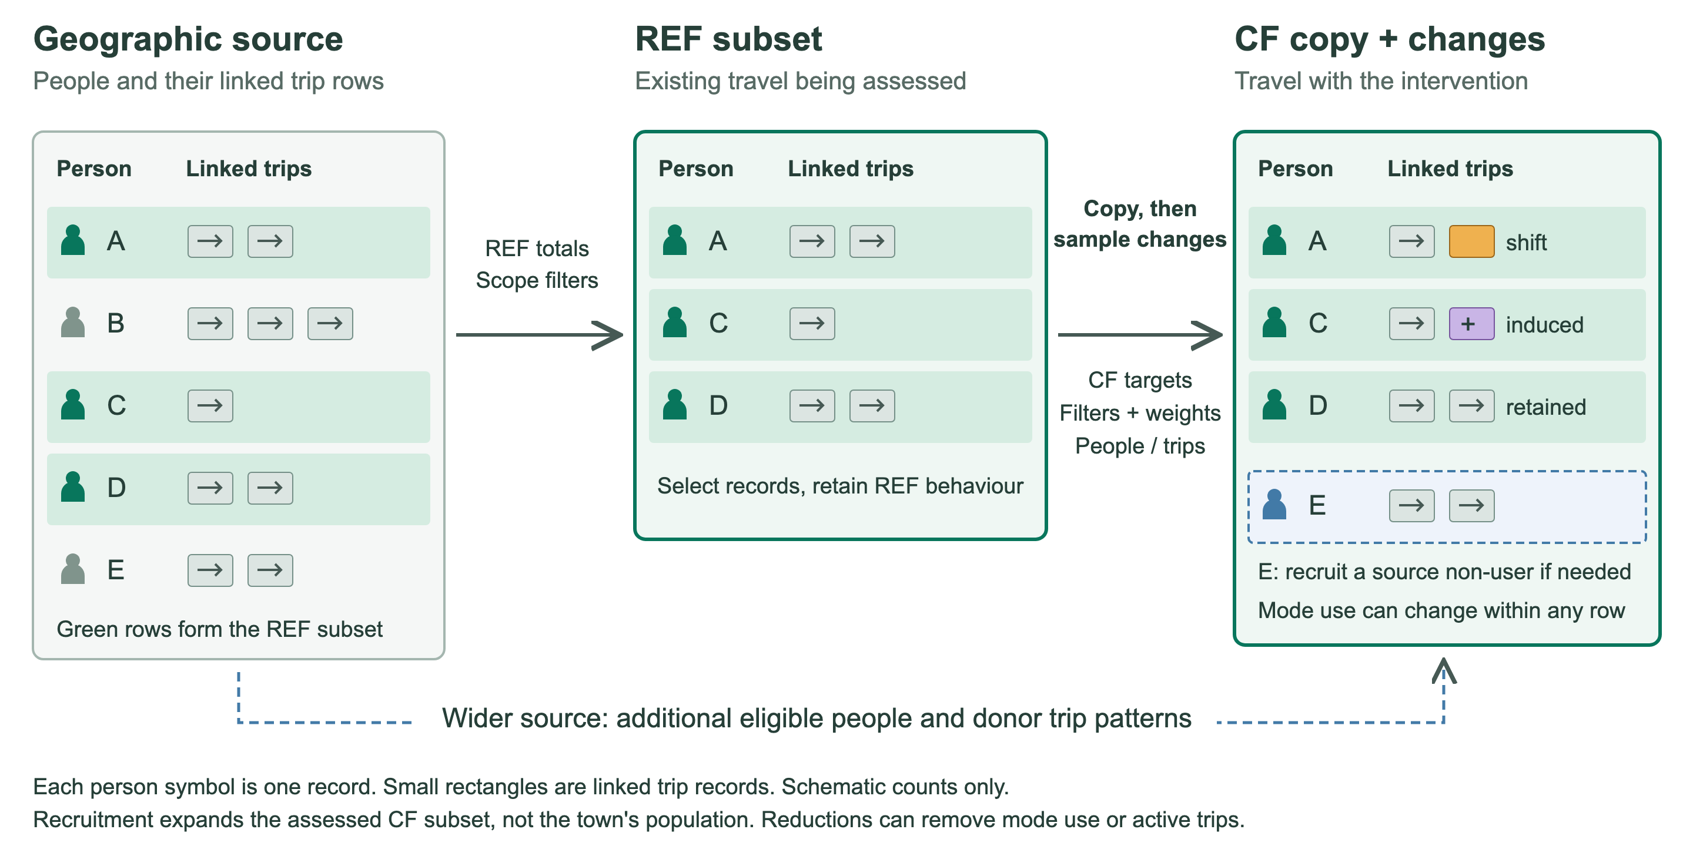
Source population => REF => CF <- intervention
With the tool we collect information to sample REF and CF
Notes:
Green source rows form the illustrative REF subset. CF starts as a copy. The CF target, eligibility filters and sampling weights determine which people and trips change.
Person A illustrates a mode switch. C receives an induced trip. D remains unchanged. E illustrates recruitment of an eligible existing source non-user from outside REF. E is not a new resident or a duplicated person. A person can use more than one mode, while an already shifted trip cannot shift again.
The lower arrow represents the wider geographic source as a pool of eligible people and donor trip patterns. Reusing a donor trip pattern may support a fixed trip target without changing fixed user counts. Lower CF targets can reduce active-mode use instead. The next slide explains priorities and fallbacks. The diagram is schematic, not a quantitative example.

Slide 14
Walk through
https://hiq-miama-ui.share.connect.posit.cloud/
https://miamat.org/

Slide 15
Source data for sampling Individuals + Trips
Real Population (Entire LAD pop) Leeds: 800k
Synthetic pop. (Source data) (1:20, (1:120))
Duplicates if needed
Reference Data (Entire or sub pop)
Primary source
Primary source
Counterfactual Data (+- REF)
New users and induced trips if needed

Slide 16
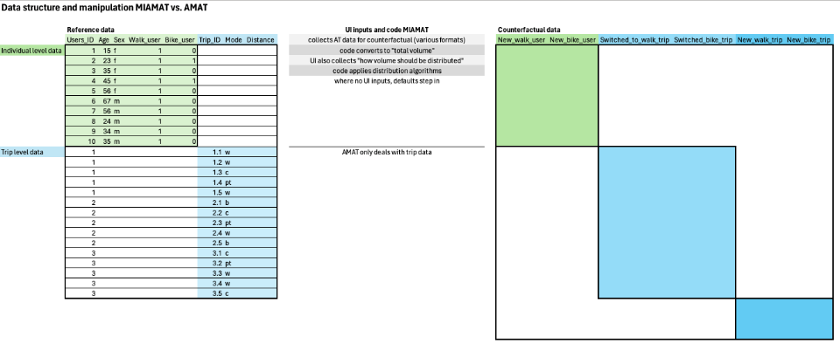

Slide 17
Scaling of real vs. synthetic Individuals + Trips
Real Population (Entire LAD pop) Leeds: 800k
Synthetic pop. (Source data) (1:20, (1:120))
1:20, (1:120))
Reference Data (Entire or sub pop)
User inputs in “real” units
Counterfactual Data (+- REF)
-> Results in “real” units

Slide 18
Tab 1: the source population
An appraisal starts with a place.
Select a Local Authority District (LAD), such as Leeds.
The app draws on a synthetic population: people with linked travel and physical-activity information.
Local patterns provide starting values for your appraisal.
Your assessed population can be smaller than the whole district.
Notes:
MIAMA estimates the health implications of a change in active travel. The source population supplies both reference information and examples of existing travel behaviour for sampling.
Synthetic people represent population patterns. They are not identified residents or a list of actual scheme participants. People and trips are linked, so the app can estimate who receives additional physical activity.
The geographic source and the population assessed by a particular scheme are distinct. For a demonstration using the Leeds sample profile, explain that it contains 5,000 synthetic people and is a testing dataset, not the full Leeds population. Availability depends on the deployed data profile.
Sources: docs/methodology.qmd, Reference synthetic population; README.md, Tab 1 and runtime data profiles.

Slide 19
Tab 2: active-travel volume
Describe travel in the reference and intervention scenarios.
Users: number of people using each mode.
Trips: number of trips, with a timeframe.
Distance or duration: travel distance or time.
Mode shares: percentages, with a total travel amount.
Initial values come from the source population. Edit these to describe your scheme.
Notes:
Reference means the situation used for comparison. Counterfactual means the situation expected with the intervention. These are two scenarios, not necessarily two different dates.
Choose one of the four input routes. Distance and duration are alternatives within one route. Check whether inputs are totals or per person and check the timeframe. Mode shares require a denominator: a percentage alone does not describe the size of a scheme.
For example, enter 15,000 reference walking trips and 20,000 intervention walking trips per week. Those are illustrative inputs, not a prediction or observed result. The app estimates the people associated with that travel. With user inputs, it estimates corresponding trips instead.
Basic mode uses assumptions to complete the assessment without requiring the advanced refinement steps. Selected modes may include walking, cycling, e-biking and walking associated with public transport.
The initial values are suggestions, not estimates of your intervention. REF describes the existing active travel you want to assess. CF describes the expected total with the intervention, not just the increase. In the example, enter 20,000 as CF, not 5,000. Source patterns and assumptions fill in information you have not supplied, such as trips per user.
In the basic workflow, people who supply trips, distance/duration or mode shares can optionally specify the assessed population as additional information. Otherwise the app uses its population estimate. Basic users can then proceed to results without reviewing Tabs 3 and 4.
Sources: R/tab2_input_conversion.R; docs/methodology.qmd, Basic specification and Continuity from Tab 2 to Tabs 3 and 4.

Slide 20
Tab 3: the assessed population
First set the scope, then refine the distribution.
Scope: adjust REF and CF counts and eligible population categories.
Distribution: refine age, sex and physical-activity patterns.
Scope supplies count targets and filter criteria.
Sampling weights favour particular people within the eligible pool.
Starting values come from Tab 2.
Notes:
Basic population refinements change the assessed scope. Advanced distributions influence which people or trip patterns are more likely to be sampled. The distinction matters because the same number of additional trips can have different health effects depending on who receives the activity.
Explain these as two separate operations. Scope answers ‘how many people, and which categories are eligible?’ Distribution answers ‘among those eligible, who is more likely to be selected?’ Excluding an age or physical-activity category is a filter. Changing a preferred age, sex balance or activity distribution changes sampling weights. A weight is a relative selection preference, not a guarantee of an exact realized category count.
Tab 2 provides the starting values. If you supplied trips, population refinements should preserve those trip totals until you explicitly change them in Tab 4. If you supplied users, Tab 3 establishes the user numbers and Tab 4 refines trips within that population. Tab 4 should not infer a different population merely because trip counts change.
New users means people starting to use an active mode. Newly induced trips means additional trips that did not exist in the reference scenario. A current user can make a newly induced trip. A new user can switch an existing trip from another mode.
The model samples from eligible source people and trip patterns. A person may use several modes, but an already shifted trip cannot be shifted again to another mode. Defaults and eligibility rules can constrain what is feasible.
REF determines the starting scope and current mode users. CF specifies the desired situation after the change. For an explicit user-count example, REF = 100 cyclists and CF = 120 cyclists means retaining the current cyclists and recruiting 20 eligible source non-cyclists. The model can draw these from outside the assessed REF subset but within the retained geographic source. CF = 80 instead means selecting 20 current cyclists to stop that mode use, not deleting 20 residents.
When the input is trips rather than people, a rise in trips does not imply the same proportional rise in users. Existing users can make more trips. The current/new-user assumption helps allocate the additional travel when user counts have not been supplied explicitly. Explicit user counts take precedence over that assumption. Advanced age, sex and activity distributions influence sampling probabilities.
Sources: R/api_refinement_profile_defaults.R; R/counterfactual_data_apply_ui_values.R; docs/methodology.qmd, Continuity and Counterfactual sampling and redistribution.

Slide 21
Tab 4: trips
First set trip scope, then refine trip patterns.
Scope: adjust REF and CF trip totals. Keep population fixed.
Distribution: refine distances and source modes for shifts.
Scope supplies counts and filters. Distributions guide weights.
Separately, specify the share of newly induced trips.
Changes to active modes change physical activity, change health.
Notes:
Travel becomes physical-activity exposure through active time and the intensity of the activity. The calculation accounts for existing physical activity, rather than treating every added minute as having the same health benefit for everyone.
Use the same scope-versus-distribution distinction as on Tab 3. Trip totals define how much travel is assessed. Eligibility rules determine which source trips can contribute; distance distributions and diversion assumptions guide selection among candidates. Source-mode diversion preferences may be implemented through mode-specific allocation as well as weights. Do not imply that every Tab 4 distribution is a hard exclusion rule or an exact quota. In particular, the legacy basic distance slider is not a fully operational trip-scope filter in HUB; the operational distance-distribution controls guide sampling instead.
For REF = 15,000 and CF = 20,000 walking trips per week, the requested net increase is 5,000. The model starts with REF and samples changes toward the CF target. Source-mode assumptions guide which existing trips switch. The induced-trip assumption determines the share added as new journeys. Current/new users and shifted/induced trips are distinct splits. One person may use multiple active modes, but a shifted trip is unavailable for a second shift.
People’s available trip patterns, sampling constraints and any explicit population targets govern allocation. Where the accepted user pool owns too few observed trips, donor-pattern sampling with replacement can support the trip target. That reuses a travel pattern; it does not permit the same existing trip to switch twice.
Trip inputs in Tab 2 remain authoritative until an explicit Tab 4 edit supersedes them. Tab 4 refinements should preserve the accepted Tab 3 person counts. The resulting trips per person can therefore change. Review both tables when testing this handoff.
HUB uses precomputed MIAMA-HM health trajectories and exposure-response lookup information. It does not rerun the entire health microsimulation for each click. The lookup varies by health-model strata and cycle. HALYs combine survival with adjustments for ill health.
The assessment period is configurable. Use the period shown in the app rather than promising a fixed number of years here. This is a model of expected health effects under the scenario assumptions, not a forecast of individual outcomes. These slides describe the physical-activity health pathway; they do not claim to include every transport benefit or harm.
Sources: R/counterfactual_data_apply_health_outcomes.R; docs/methodology.qmd, From physical activity to health trajectories and Health-adjusted life years.

Slide 22
Sampling: priorities and fallbacks
CF starts from REF. The requested difference drives sampling.
Priority: explicit counts prevail. Tab 4 preserves Tab 3 people.
People: eligible REF non-users first, then the wider source.
Trips: shifts plus induced trips. Each trip can shift once.
Fallbacks: relax weights, reuse trip patterns, or add induced trips when shifts fall short.
Filters remain binding.
Notes:
REF inputs establish the starting scope. CF inputs specify a target situation, so the difference determines whether the model samples additions or reductions. CF initially copies REF. This is why two CF totals of 120 users represent different interventions when REF is 100 versus 50.
INPUT PRIORITY. Explicit user-count inputs take precedence over a default current/new-user percentage. For a trip-based Tab 2 route, the trip target remains binding through Tab 3 unless explicitly changed in Tab 4. Tab 3 determines the accepted person counts. Tab 4 may change trips per person but should not infer a new population. Later explicit Tab 4 trip counts supersede earlier estimated trip counts or trip targets derived from mode share or distance/duration. Otherwise the upstream input remains authoritative.
PEOPLE. To increase mode users, first select eligible baseline non-users already inside the assessed population. Recruit a shortfall from eligible non-users elsewhere in the retained geographic source. A person can use several modes. People are not duplicated to satisfy a user-count target. If too few eligible people exist in the full source, a revised target or category selection is needed. Fewer CF users means selecting current users to reduce or stop the mode, while retaining the people for health accounting.
TRIPS. To increase active trips, switch eligible existing trips according to the source-mode assumptions and add the induced share. Keep already-shifted trips unavailable for a second shift. If the fixed user pool owns too few observed trip patterns to meet a fixed trip target, sample geographic donor patterns with replacement and assign them to the fixed people. This creates modeled trip records, not duplicate people. A shortfall of switchable CF trips can become induced trips, changing the realized shifted/induced split. Reports retain these mechanism counts. Fewer active trips means switching eligible active trips away.
WEIGHTS AND FILTERS. When there are insufficient positive-weight candidates, the implementation can fill the unavoidable remainder uniformly from other eligible candidates. It does not thereby reintroduce an excluded category. Category selections can also trigger a warning and adjustment of stale submitted scope totals to eligible capacity. These are distinct from unconstrained replication or ignoring a filter.
ZERO REFERENCE. Zero REF activity with positive CF activity still needs people. HUB derives a person boundary from CF volume, with the geographic person pool as a fallback if a source rate is unavailable. Zero REF mode trips/users do not mean an empty geographic donor population.
Sources: README.md, Feasibility rules and sampling sources and What happens when a requested sample cannot be drawn; R/reference_data_apply_appraisal_scope.R; R/counterfactual_data_sampling_functions.R; R/counterfactual_data_apply_ui_values.R.

Slide 23
Tab 5: health impacts
Activity changes affect modelled health outcomes.
Calculate the outcome difference: CF minus REF.
Lower disease and mortality outcomes indicate a benefit.
Report prevented deaths and disease cases, life-years gained and health-adjusted life-years (HALYs).
These four are separate outcomes and should not be added together.
Results by mode are an allocation of the combined result in proportion to each mode's mMET contribution, not separate model runs.
Inspect plots and exports over the assessment period.
Results depend on the input estimates, source data and modelling assumptions.
Notes:
Begin testing with a plausible scenario, then vary one input while keeping the others fixed. Check whether the population and trip tables remain understandable as you move through the app. Check that reference and intervention trip results reflect the intended scenario and any explicit refinements.
HALYs means health-adjusted life-years: a measure combining length of life with health during those years. Distinguish life-years gained from deaths prevented; they answer different questions. Disease-case totals are counts of outcomes and do not necessarily count distinct people.
The technical outcome difference is CF minus REF. For adverse outcomes, such as disease cases and deaths, a reduction is therefore negative. The app reverses the sign for ‘prevented’ results: REF minus CF, so benefits display as positive. For life-years and HALYs, gains use CF minus REF. Avoid describing all headline results as raw risk differences: they summarize expected events or years of life over the assessment period, with the configured population scaling.
For feedback, record the data profile and geography, selected modes, input route, reference and counterfactual inputs, refinements, and the unexpected output. Include a screenshot or export where useful. Please flag apparently implausible outputs even when the app does not show an error.
Sampling can introduce variation. Small effects and rounded headline values need careful interpretation. Outputs are conditional model estimates and do not themselves quantify all sources of uncertainty.
Sources: R/results_data_prepare.R; README.md, Tab 5: Present and export results; docs/methodology.qmd, Validation, uncertainty, and remaining work.

Slide 24
Exports: taking results out of the tool
The Export tab hands you the run's outputs as files.
Results data table: the numbers behind the plots, as CSV or Excel.
Plots package: a ZIP of the figures shown in the tool.
AMAT inputs: one row per outcome per year, annual and cumulative.
Report: a Word or PDF write-up of the run.
Each download belongs to the run that produced it, so record the scenario settings with it.

Slide 25
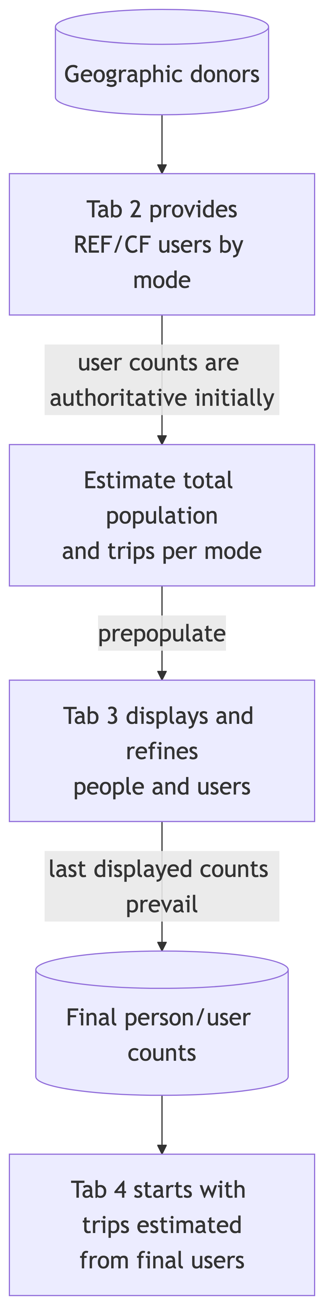
Backup: user-count inputs
Notes:
User counts are the provided quantity. Source patterns supply initial trip estimates. Tab 3 establishes the final person targets, and Tab 4 can adjust the trips assigned to those people.
Full-resolution diagram: User-count route. Open the original PNG and zoom for detailed discussion. Source: docs/ui_data_authority_workflow_diagrams.qmd.

Slide 26
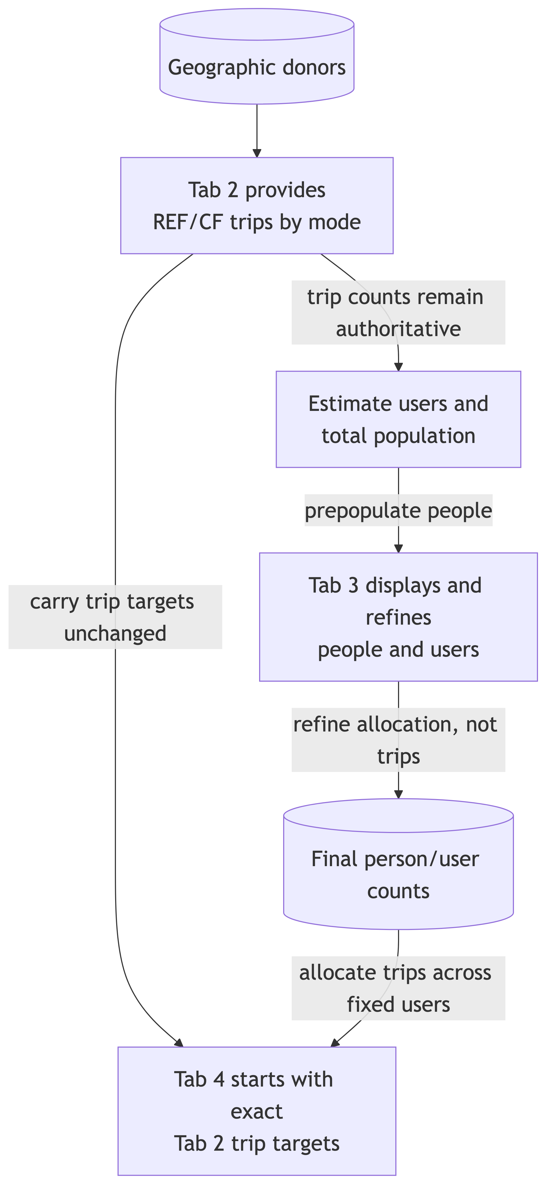
Backup: trip-count inputs
Notes:
Trip counts are the provided quantity. The app estimates the people needed to represent that travel. Population refinements preserve the trip targets until an explicit Tab 4 edit. Changed user counts therefore change trips per user.
Full-resolution diagram: Trip-count route. Source: docs/ui_data_authority_workflow_diagrams.qmd.

Slide 27
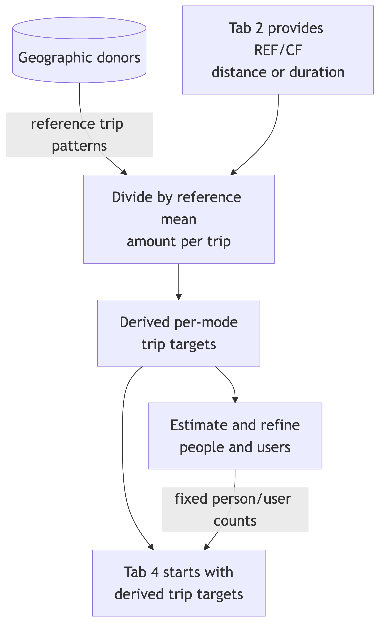
Backup: distance or duration inputs
Notes:
The app converts supplied distance or duration into estimated trip counts using source means per trip, then derives person equivalents. Realized totals reflect sampled trip patterns; these are not guaranteed to reproduce an exact aggregate distance or duration. A later explicit Tab 4 trip count supersedes the derived trip count.
Full-resolution diagram: Distance/duration route. Source: docs/ui_data_authority_workflow_diagrams.qmd.

Slide 28
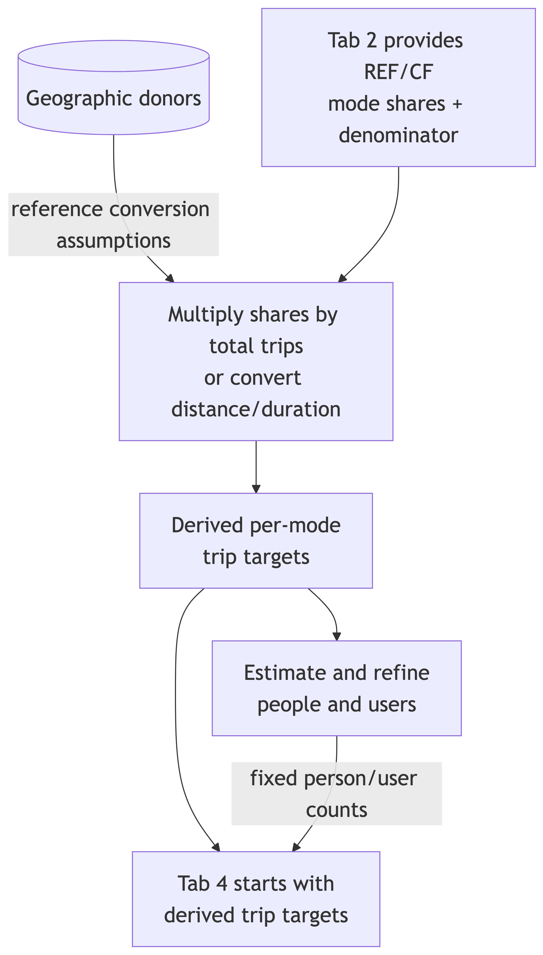
Backup: mode-share inputs
Notes:
The app combines mode shares with the supplied or suggested denominator to derive per-mode trip targets. Shares alone do not define population size. Later explicit trip edits can change the realized shares.
Full-resolution diagram: Mode-share route. Source: docs/ui_data_authority_workflow_diagrams.qmd.

Slide 29
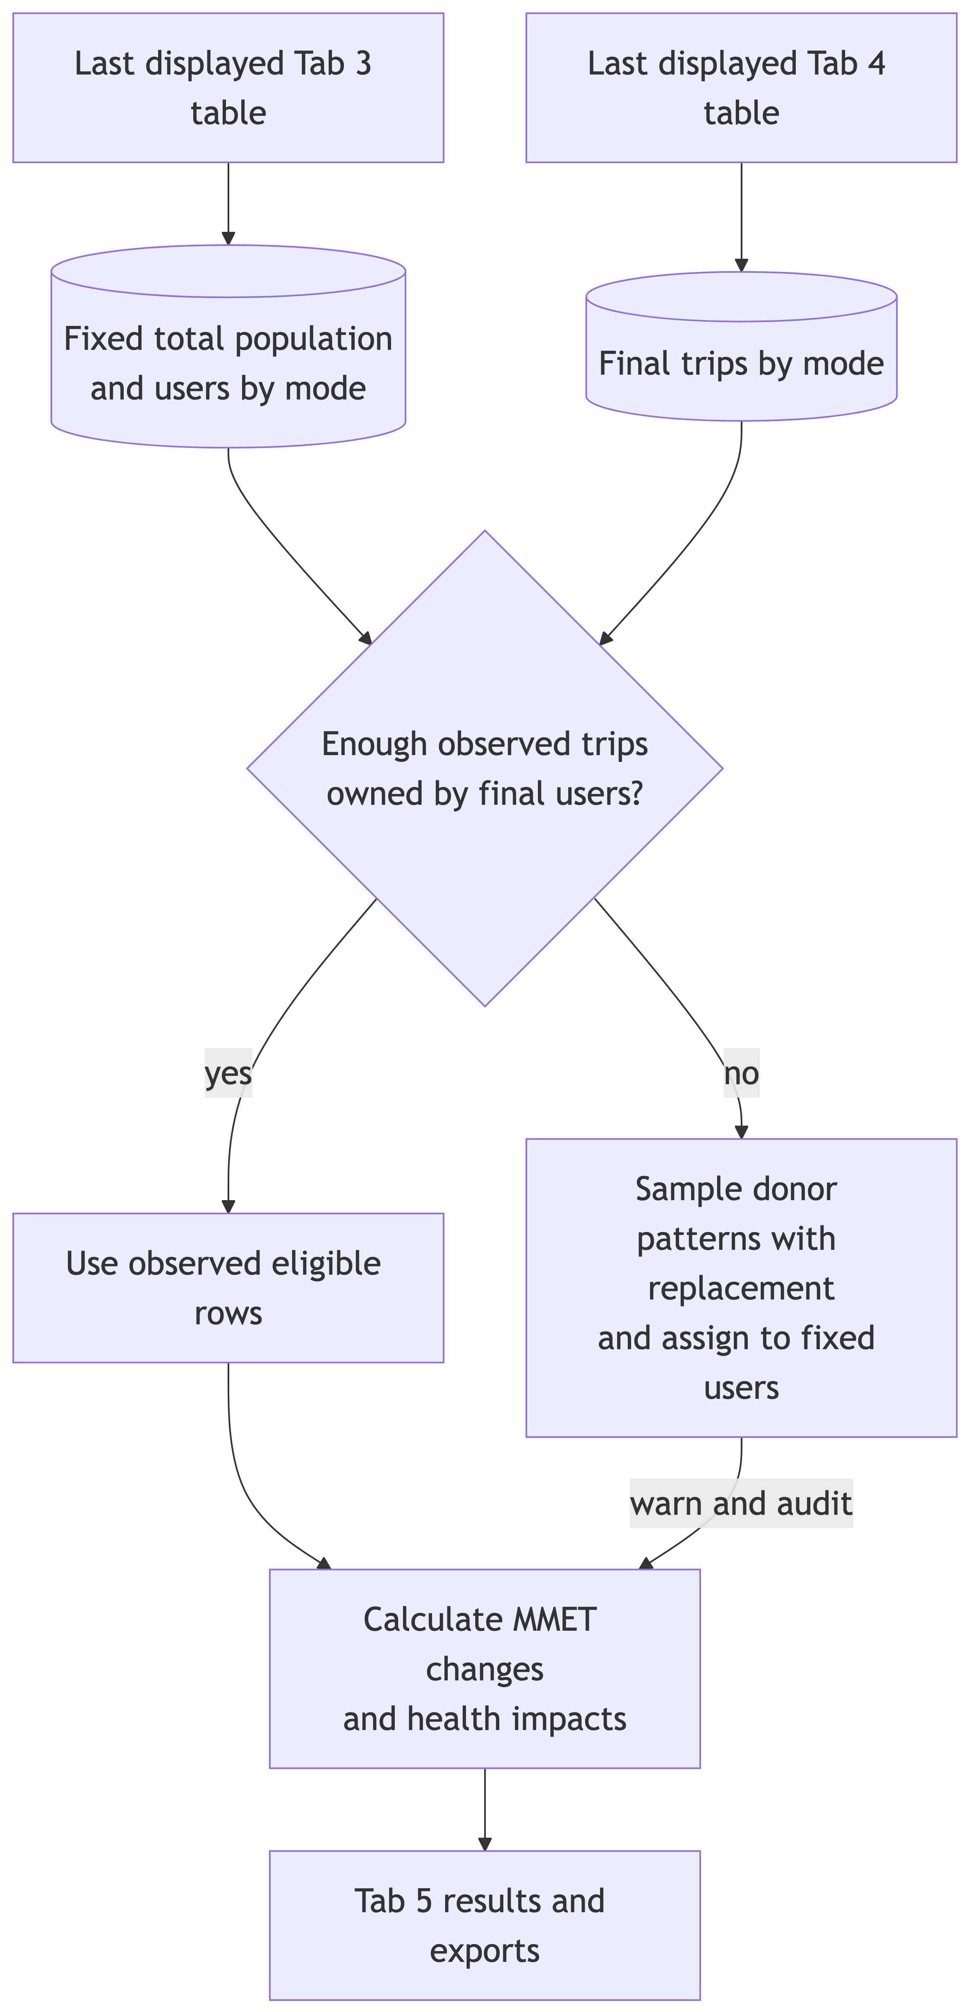
Backup: population-to-results handoff
Notes:
Trace how accepted population counts pass to trip allocation and final results. The aim is a forward sequence: later trip refinements do not recalculate the accepted person counts. Filters and sampling weights refine allocation within this sequence.
Full-resolution diagram: Tab 3 to results. Source: docs/ui_data_authority_workflow_diagrams.qmd.

Slide 30
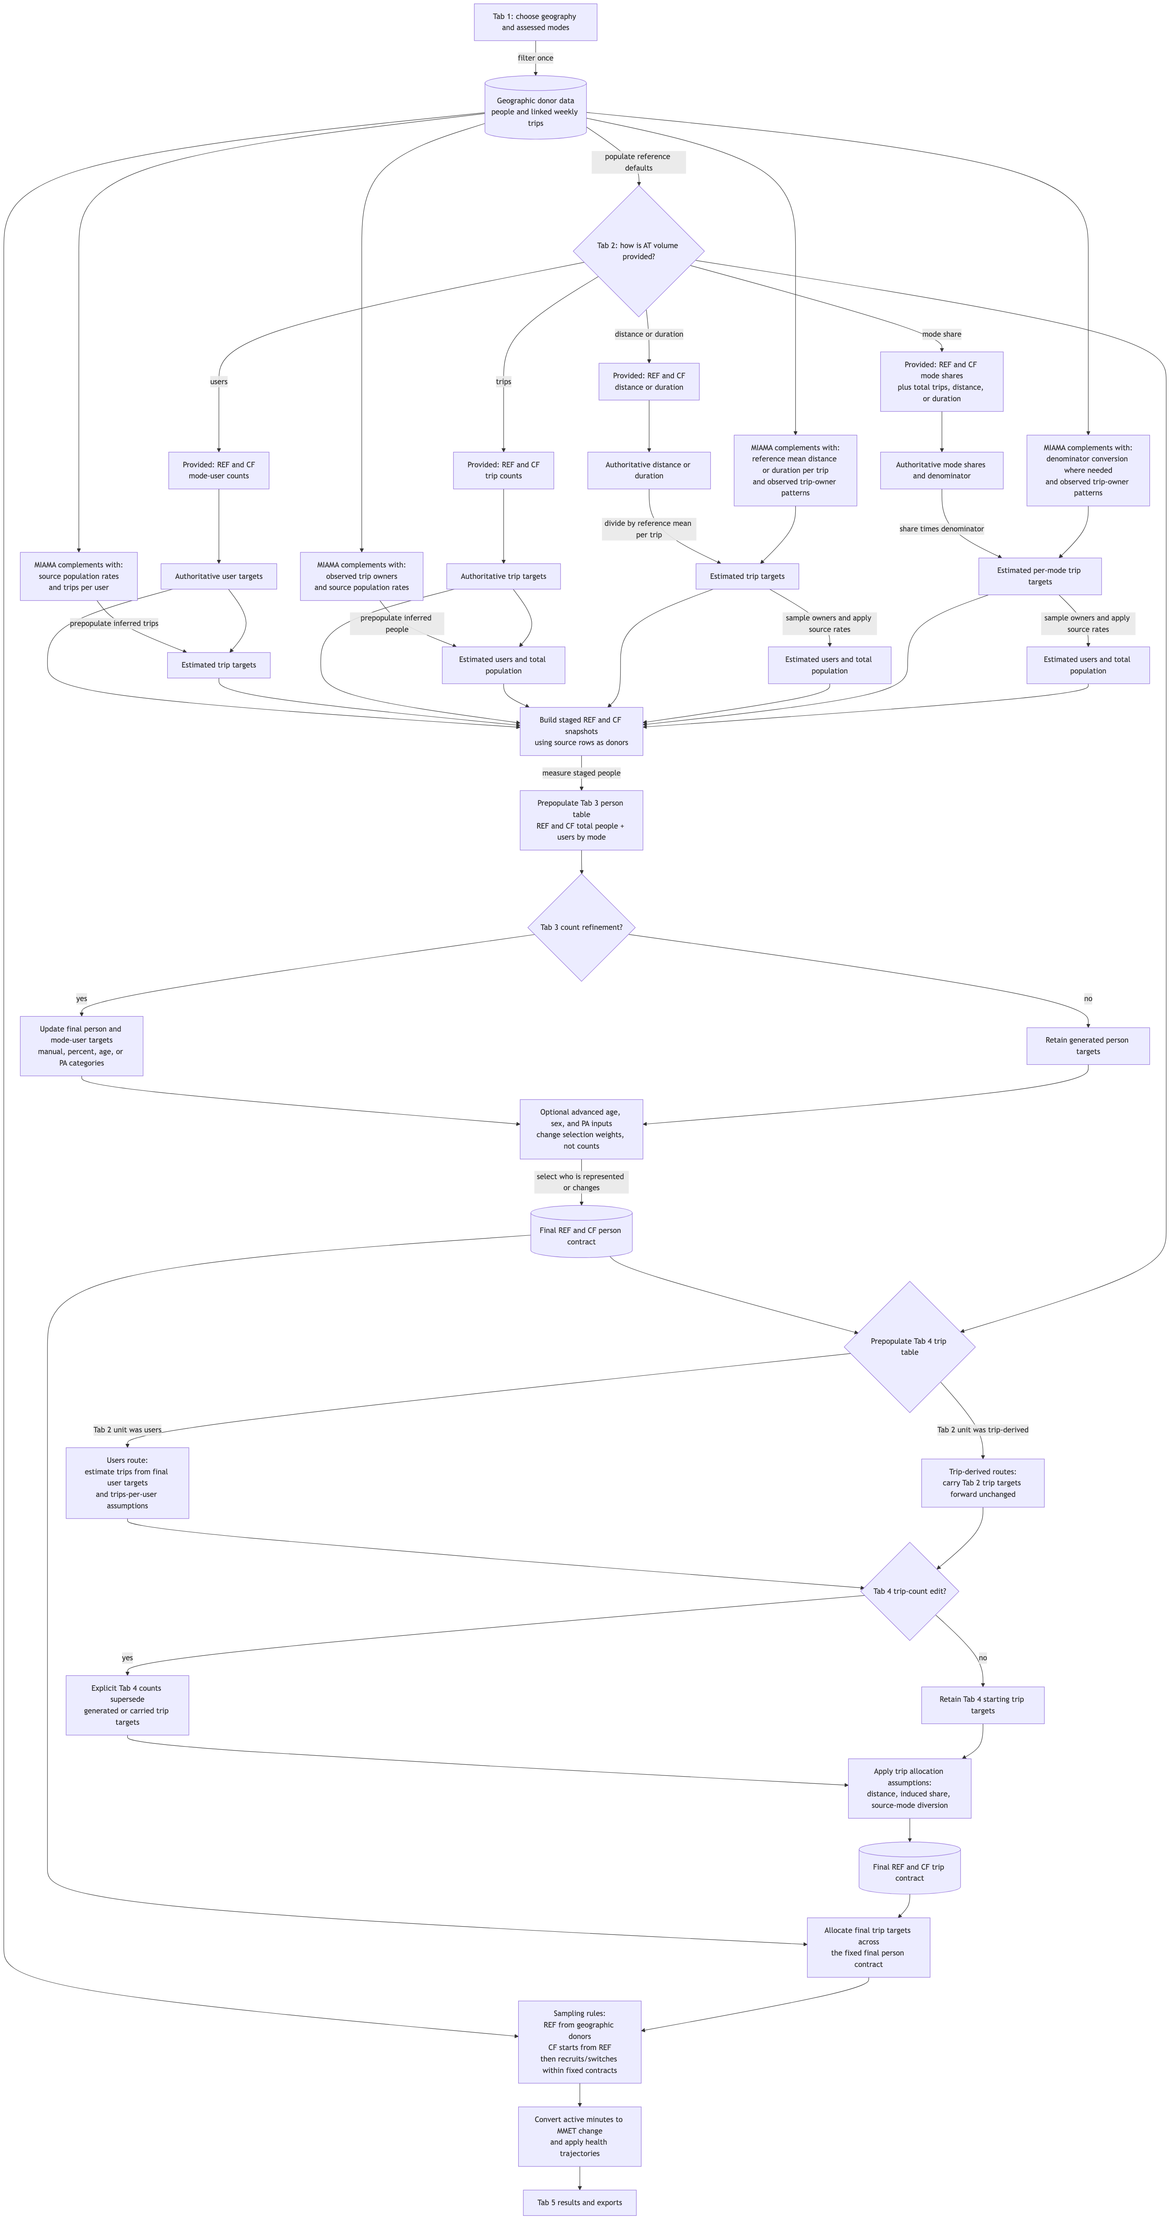
Backup: complete workflow
Notes:
Use this as an orientation map, not a diagram to read box by box when projected. The preceding route-specific backups are easier to discuss. The complete workflow connects source data, all four Tab 2 routes, population and trip refinements, sampling, and health results.
Full-resolution diagram: Complete workflow. Source: docs/ui_data_authority_workflow_diagrams.qmd. The diagrams describe the intended data-authority workflow; use the sampling slide and its notes for current fallback details and implementation nuances.

Slide 31
Scheme effect scaling
Effect (%)
1. In how many years will the scheme reach its maximum effect? - (Max. effect = AT Volume provided in Tab2)
2. For how many years will max. effect last?
3. After how many years will scheme effect end?
Years

